Slide 1
IGVP
A Parallel Multibit Programing Scheme With High Precision for RRAM-Based Neuromorphic Systems Junren Chen, Huaqiang Wu , Bin Gao , Jianshi Tang , Xiaobo Sharon Hu, and He Qian

Slide 2
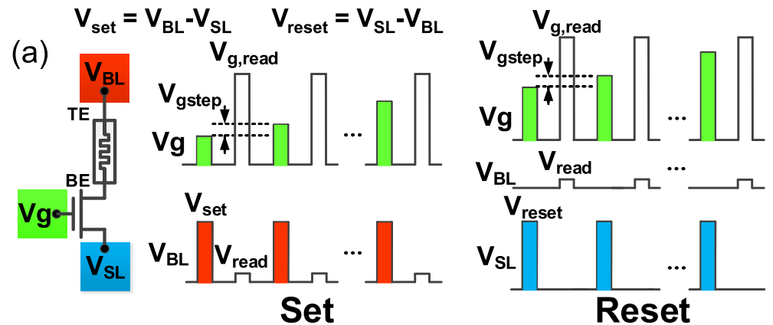
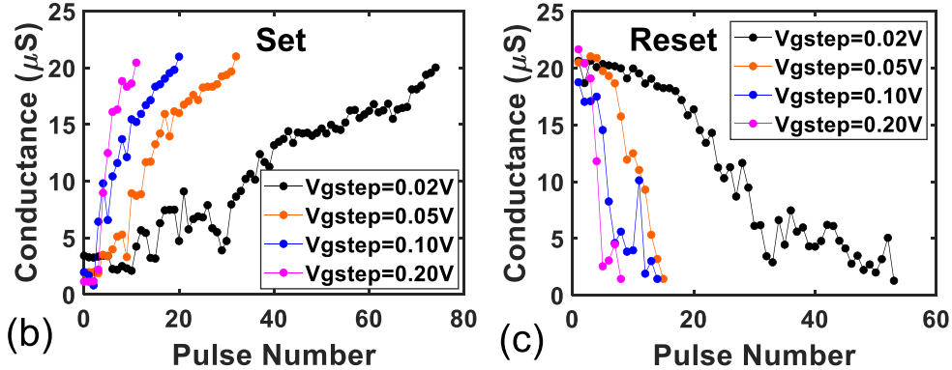
IGVP Overview
Waveform of the IGVP for set and reset
Results of IGVP of set and reset
Notes:
IGVP: only the gate voltage (Vg) of the 1T1R cell is increased step by step in both the SET and RESET processes, while the pulse voltage amplitude and width at the other two terminals (VBL, VSL) remain unchanged.

Slide 3
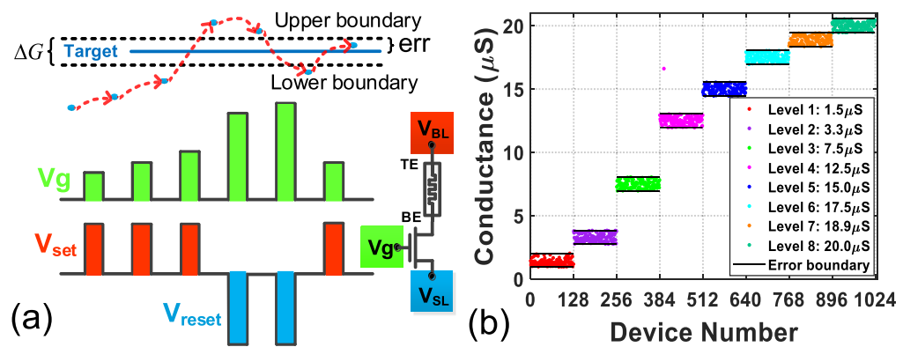
Reverse tuning exists
Arbitrarily eight target level with 6% precision.
(cell by cell)

Slide 4
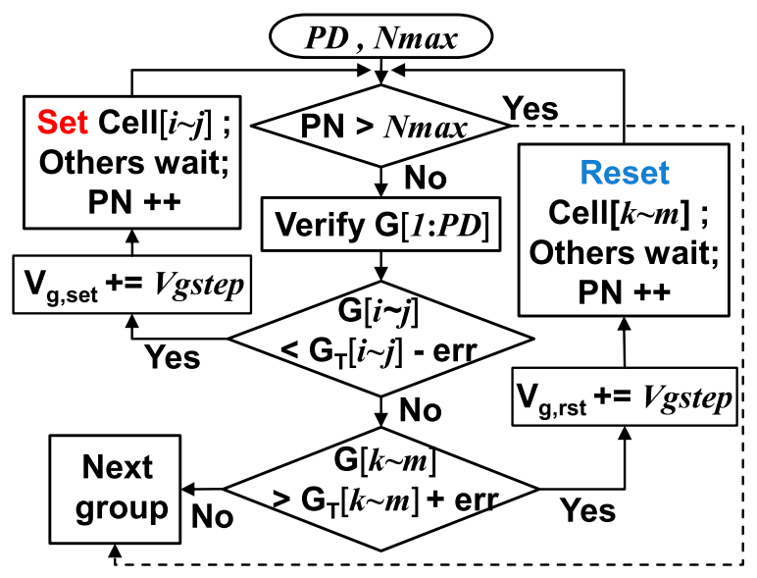
Three import parameters in this algorithm:
The gate voltage step size V_{gstep}
The upper bound on the number of programming pulses, N_{max}
The number of cells to be programed in one group, parallel degree (PD).
Flowchart of IGVP

Slide 5
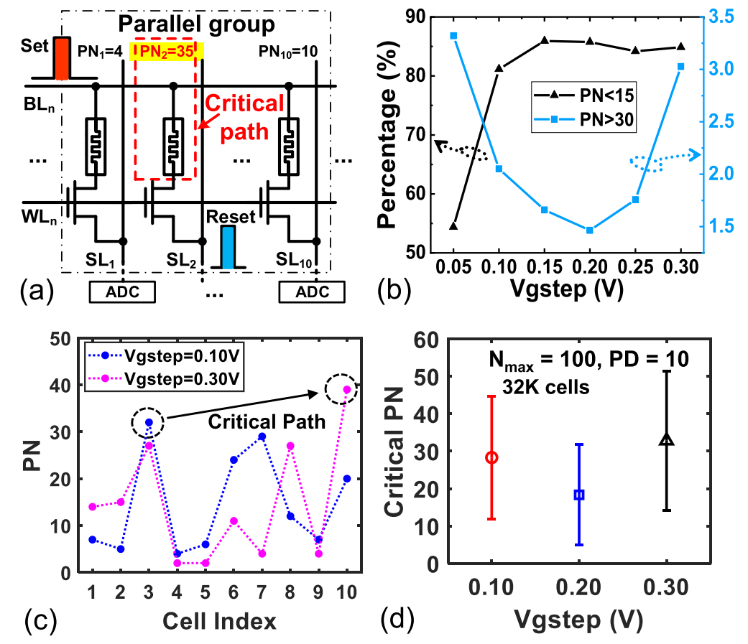
Critical Path Optimization and the Effect of V_{gstep}
Critical path illustration
V_{gstep} 对critical path比例的影响
这个不是由短板决定的吗？分析这个有什么用呢？
V_{gstep} affects the programming speed by changing the critical path in the parallel groups
最终N_{max} 还是可以下降的，但是这个V_{gstep} 是不是跟工艺，甚至是温度强相关？
V_{gstep} 变成0.3V，critical path变了，这又有什么用呢？关注的不应该是critical path需要的PN吗？

Slide 6
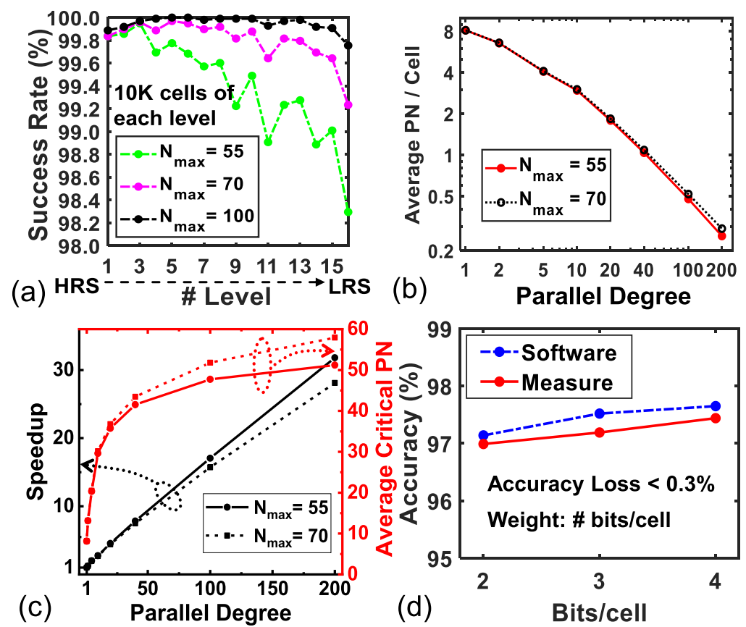
Statistical Analysis of N_{max} and PD
PD↑→ average required PN per cell↓
When PD increases from 1 to 10, the required PN per cell decreases from 8.1 to 3.0 with only 2.7 times speedup. This is essentially caused by the increase in the average critical path.
N_{max}↑ → success rate↑
ACPN increases rapidly
# bits/cell增大，accuracy反而升高了
A larger N_{max} with PD>100 causes a larger ACPN, thus lower parallel efficiency. 得到这个结论的前提是ACPN饱和，最终小的N_{max} 得到的效果跟大的肯定不一样，怎么有可比性？
这边介绍PD=10时，ACPN=1.7就可以实现99.93%的bit success rate，但是为什么不说自己的N_{max} 设置的是多少呢？
这边都不应该分析均值，而应该分析u+3σ点

Slide 7
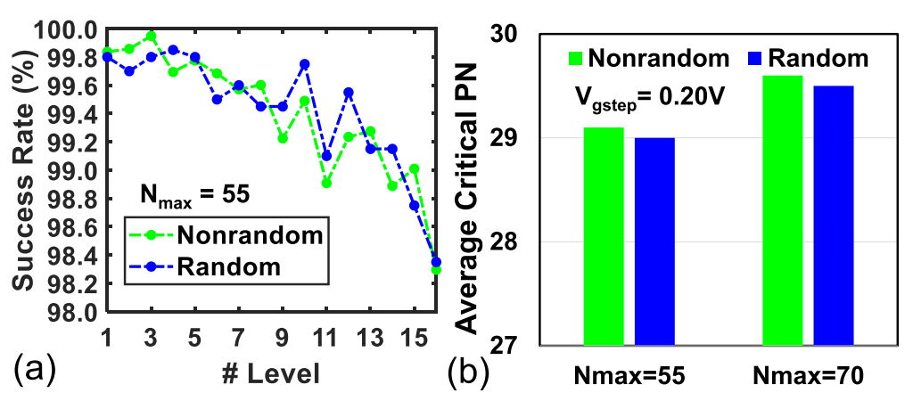
Influence of Data Patterns in Parallel Groups
No influence !

Slide 8
Conclusion
Limitations
这篇文章分析的都是平均需要的PN，但是实际延时是由critical path决定的，应该列出分布；
并行的时候需要多套ADC和多个verify电路；
这个方案跟process，甚至是温度强相关，实际效益仍值得商榷。

